Slide 1
Cancer
Lesson 4.3
How do tumor cells find a new home?

Slide 2
Do Now
Why did Steve Jobs’ tumor metastasize to his liver and lung but not other organs?

Slide 3
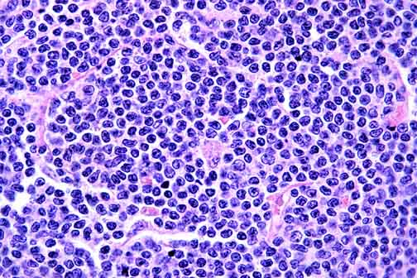
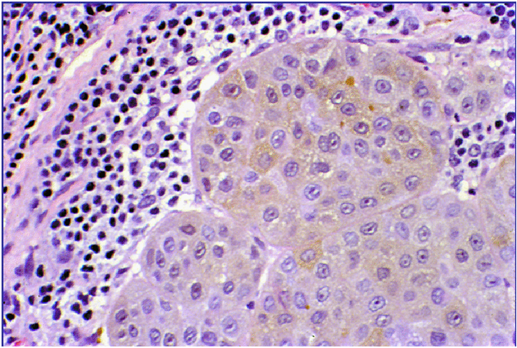
Is it primary or secondary?
Primary tumor of lymph node (lymphoma)
Secondary tumor (melanoma) in lymph node

Slide 4
Important terms
A primary lung tumor is a tumor in lung cells.
A metastatic lung tumor is a lung tumor that can metastasize to another organ.
A secondary lung tumor has originated in another organ and metastasized to lung.

Slide 5
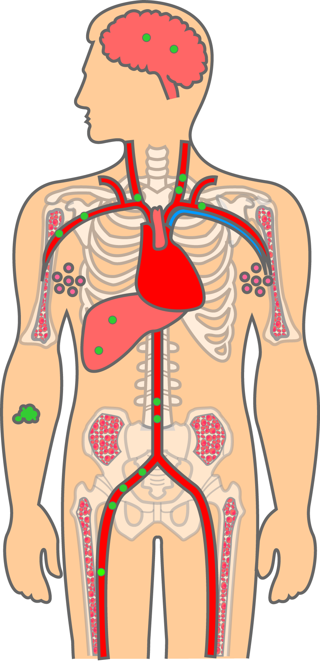
What do cancer cells look for in a new home?
Primary tumor in the skin
Metastatic (secondary)
tumors
Melanoma

Slide 6
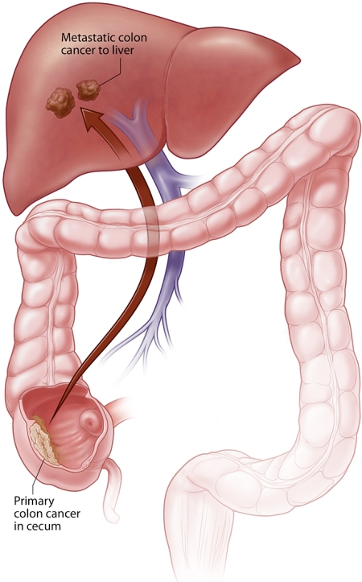
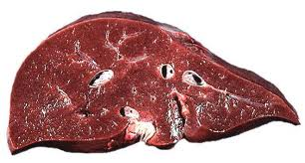
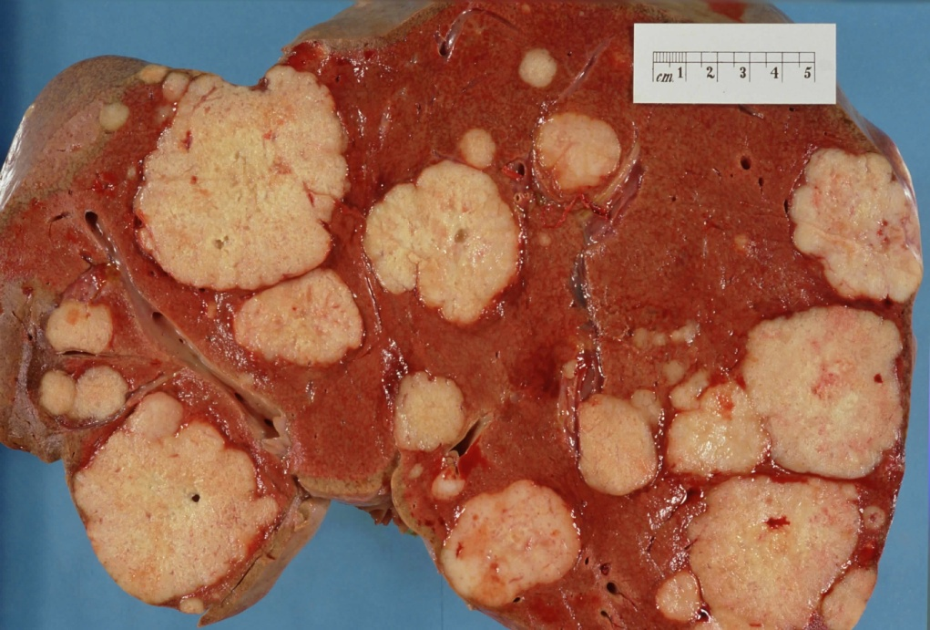
Some secondary organs are chosen because they are close to primary organ
Metastatic colon
cancer in liver
Tumors in liver
Portal vein
PP
Primary cancer
in cecum
Tumors in colon
Notes:
Added labels etc

Slide 7
Secondary organs secrete signals cancer cells recognize!
Serotonin
Notes:
I tried to fact check on this slide because it brought up a lot of questions from the students. But I haven’t found anything that says that the bone is the source of the serotonin, rather I found papers saying the gut secretes the serotonin that controls the bone mass, and also that there are tumors that secrete serotonin.
osteonectin,²³ and stromal-derived factor-1 are chemokines secreted by the bone that could attract breast and porstrate cancer cells.
Nice paper I found: http://www.ncbi.nlm.nih.gov/pmc/articles/PMC3075088/

Slide 8
Seed and fertile soil hypothesis
Metastatic cells travel in the bloodstream ‘highway’:
Do they settle at an appropriate exit (secondary organs)?
OR
Do they get off at multiple exits but only grow in one destination?
Notes:
Changed wording to make it questions on the possible scenarios that it migth be

Slide 9
Seed and fertile soil
Seeds
Soil
Lungs
Brain
Liver

Slide 10
Activity
Find the ‘Fertile Soil’: Secondary tumor sites

Slide 11
Activity
Cell line | Adhesion to liver | Growth on liver | Invasion of liver
COL-2-JCK | 5/5 | 5/5 | 5/5
Co-3 | 5/5 | 5/5 | 5/5
Co-6 | 5/5 | 0/5 | 0/5

Slide 12
Which Organs are ‘most fertile’?
Primary Tumor | Brain | Liver | Lungs | Bone
Breast | 10 | 25 | 30 | 35
Melanoma | 20 | 35 | 30 | 15
Prostate | 20 | 20 | 25 | 35
Colon | 5 | 10 | 75 | 10
Pancreas | 5 | 20 | 70 | 5
Notes:
Is this percentages? We should say that then

Slide 13
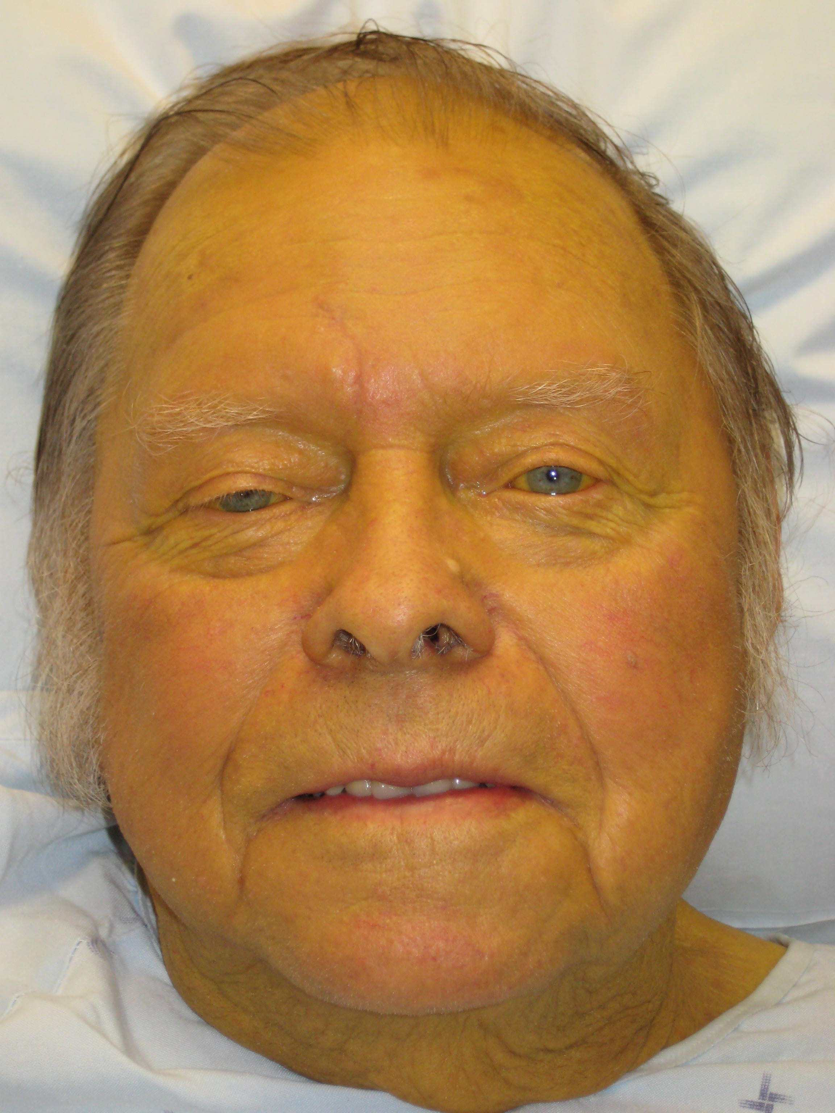
What happens when cancer cells metastasize to the liver?
Metastatic colon
cancer in liver
Primary cancer
in cecum
Yellowing complexion-Jaundice

Slide 14
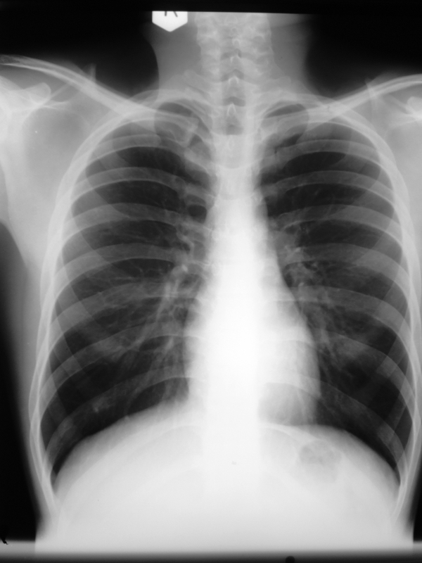
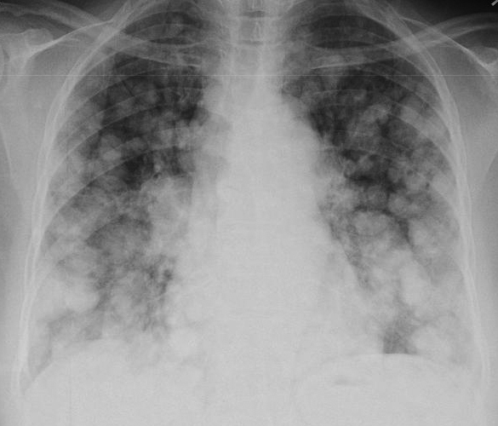
What happens when the cancer cells metastasize to the lung?

Slide 15
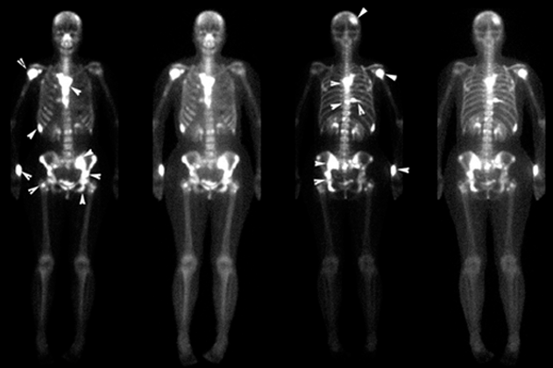
What happens when the cancer cells metastasize to the bone?
Notes:
Of the 4 images, from left to right, 1 and 3 seemed to be two different diseased people and 2 and 4 are over exposed images of each??

Slide 16
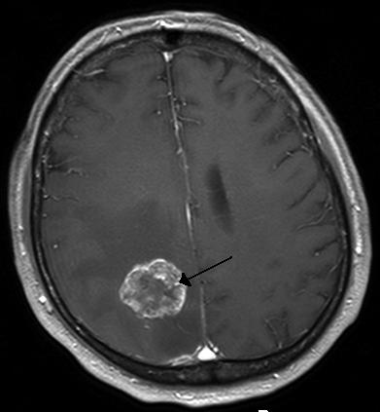
What happens when cancer cells metastasize to the brain?
Notes:
We should tell them what kind of image this is? My brain anatomy sucks!

Slide 17
Wrap Up: The real picture of metastasis?
Soil
Lungs
Brain
Liver
Bone
Spleen
Kidney
We most are more likely to find metastases in vital organs -they have the most obvious symptoms

Slide 18
Homework
Read an article about a host factor that promotes chemotherapy resistance among secondary tumors.

